Slide 1
ADHOC NETWORK TECH COMPANY
REVIEW 1

Slide 2

TALKIES
The media hub

Slide 3
Abstraction
Abstraction is a concept in programming and design that involves hiding the complex implementation details and showing only the essential features of an object, function, or system. It helps in managing complexity by allowing us to focus on the high-level design without getting bogged down by the specifics.
In the context of your HTML code, abstraction can be applied as follows:
1. Header Section Abstraction: Abstract the header section to include the logo, search bar, and login buttons. This section provides the basic navigation and branding elements for the website.
2. Main Content Abstraction: Abstract the main content section to include the music and video sections. Each section contains a heading and a scrollable list of media items.
3. Footer Abstraction: Abstract the footer section to include copyright information and design credits. This section provides attribution for the website's content and design.
By abstracting these sections, you can focus on the overall structure and functionality of the website without getting into the specific details of each element. This can make your code more readable, maintainable, and easier to modify in the future.

Slide 4
Introduction:
Introduction:
In the digital age, media consumption has become an integral part of our daily lives. From music to videos, we are constantly seeking new forms of entertainment and knowledge. "Talkies" is a modern media platform designed to cater to these needs, offering a wide range of music and video content for users to explore and enjoy.
The website features a sleek and user-friendly interface, allowing users to easily navigate through the vast library of media content. Whether you're looking for the latest music hits or educational videos on science and humanities, "Talkies" has something for everyone.
With its curated collection of media content, "Talkies" aims to provide a unique and immersive experience for users, enabling them to discover new music and videos that resonate with their interests. Join us on a journey of exploration and discovery as we delve into the world of media with "Talkies."

Slide 5
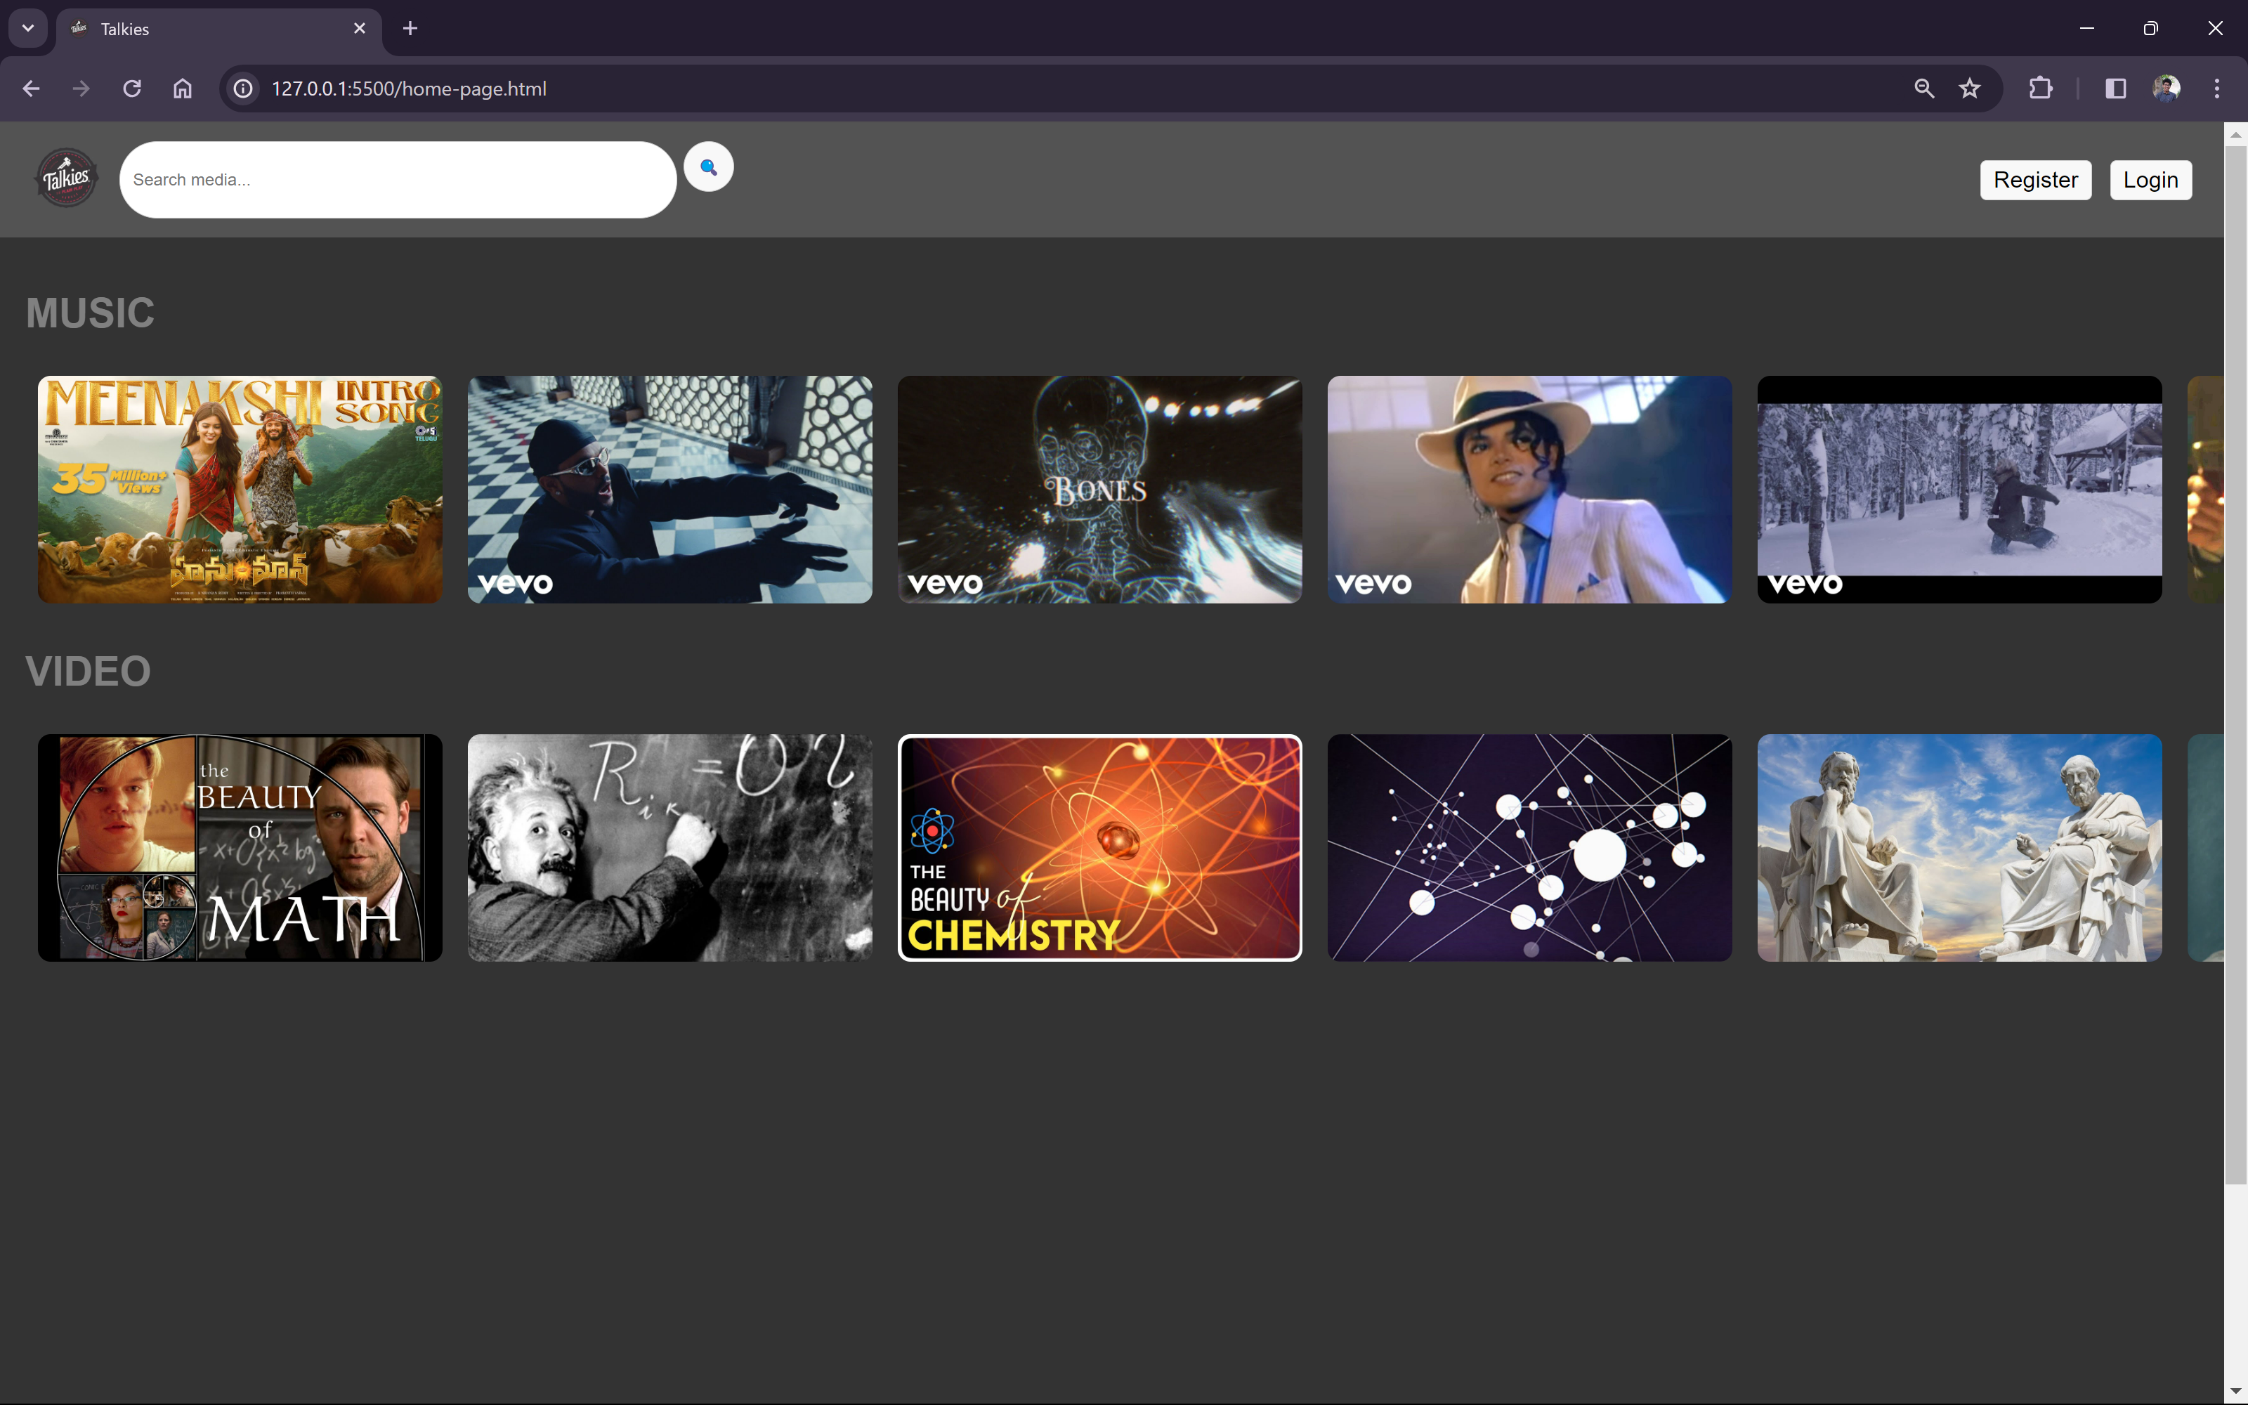
The Home Page(output)

Slide 6
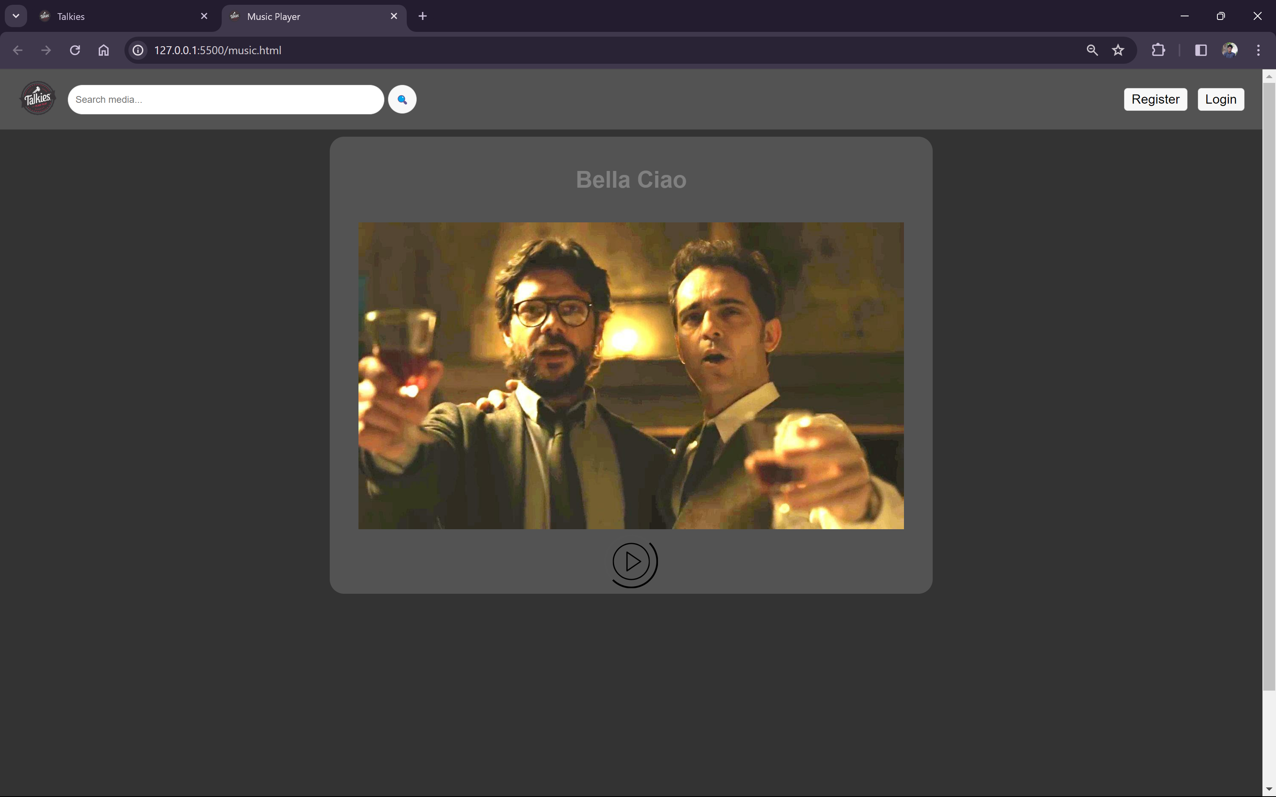
The music page(output)

Slide 7
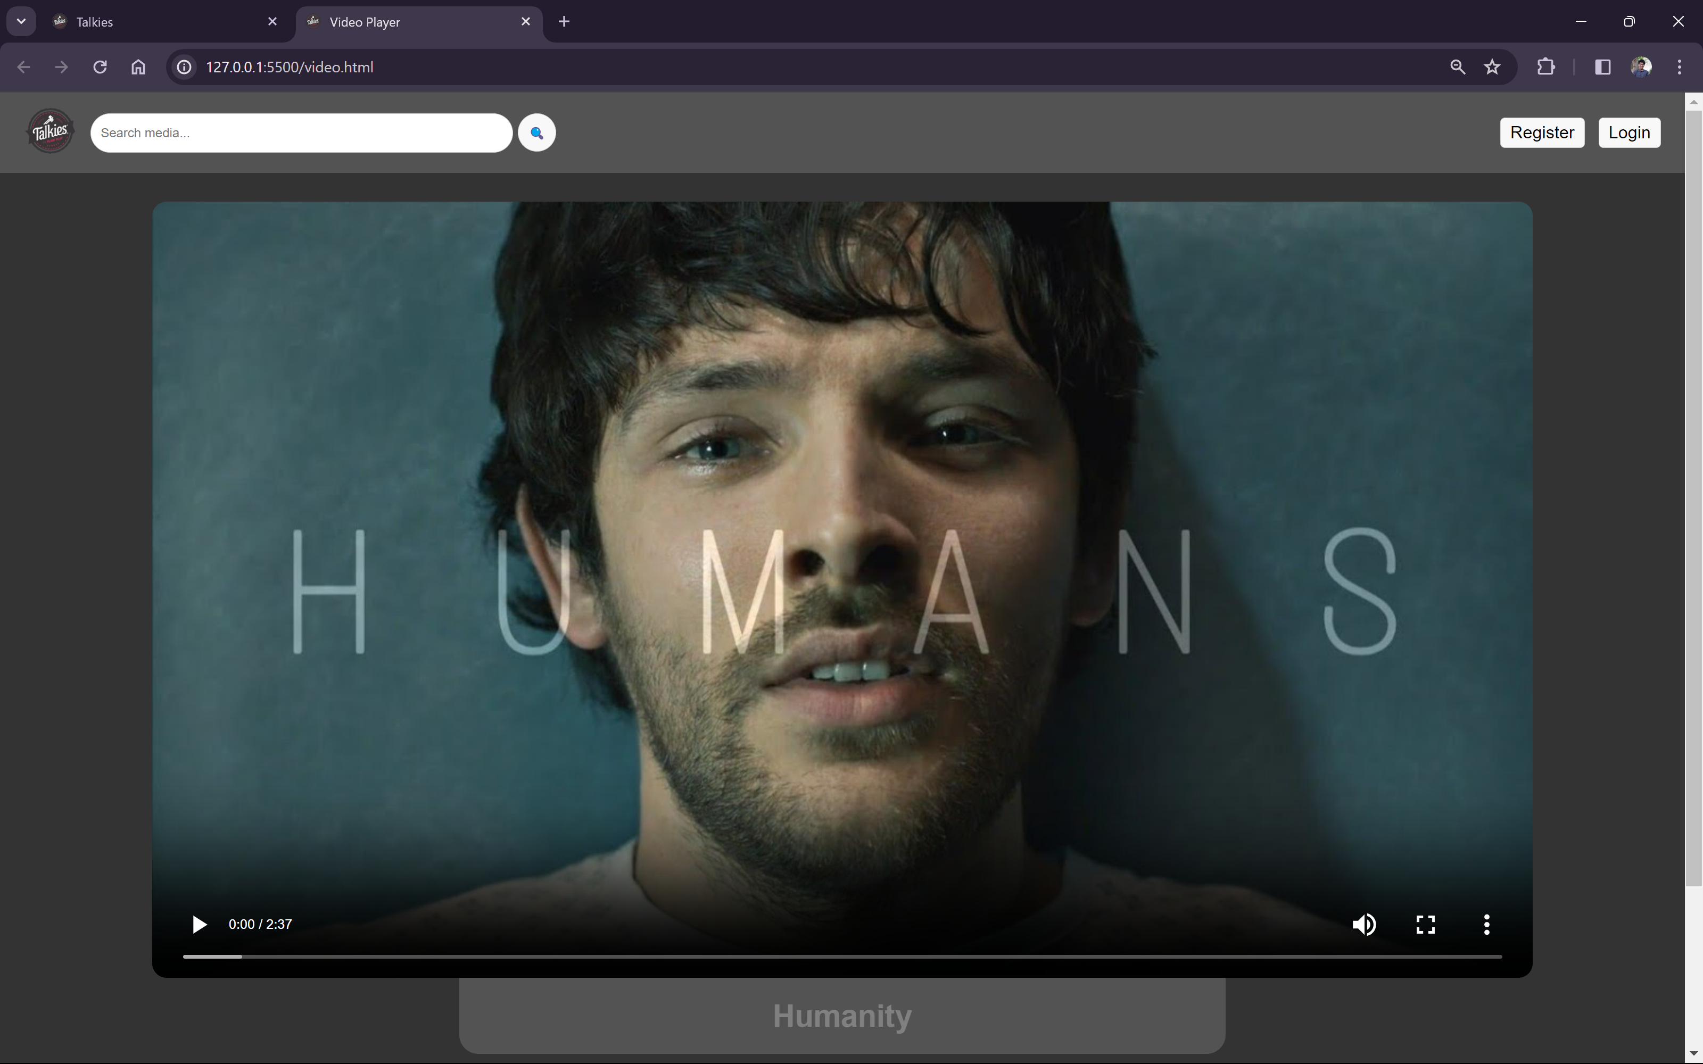
The video page(output)

Slide 8
System requirements:
System Requirements for "Talkies" Website:
1. Operating System: Compatible with Windows, macOS, Linux, and mobile operating systems (iOS, Android).
2. Web Browser: Compatible with the latest versions of popular web browsers such as Google Chrome, Mozilla Firefox, Safari, and Microsoft Edge.
3. Internet Connection: High-speed internet connection for streaming music and videos without interruptions.
4. Screen Resolution: Recommended screen resolution of 1280x720 or higher for optimal viewing experience.
5. JavaScript: Enabled in the web browser for interactive features and functionality.
6. Cookies: Enabled for storing user preferences and session management.
7. Plugins: Some features may require additional plugins such as Adobe Flash Player or media codecs for video playback.
8. Hardware: Standard hardware configuration for smooth operation (e.g., CPU, RAM, storage).
9. Accessibility: Compliance with accessibility standards (WCAG) for users with disabilities.
"Talkies" is designed to be accessible and user-friendly across a variety of devices and platforms, ensuring that users can enjoy their favorite media content seamlessly.

Slide 9
Conclusion:
In summary, "Talkies" is a dynamic and user-centric platform, crafted to deliver a delightful and immersive media experience. With its intuitive design, diverse content library, and broad compatibility across devices and browsers, "Talkies" aspires to be your ultimate destination for music and video exploration. Whether you're in search of the latest music trends or insightful video content, "Talkies" stands ready to enrich your entertainment journey with its seamless interface and engaging offerings. Join us on "Talkies" and embark on a discovery-filled adventure through the world of media.

Slide 10
THANK
YOU

